Slide 1
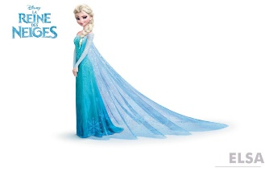
27
12
6
X 9 =
X 4 =
24
X 8 =
= 2 X
5
X 3 =
9
= 6 X
x 7 =
X 5 =
18
15
21

